Slide 1

Notes:
This slides go along with the RTTA Demo Script .docx

Slide 2
Automating Real-Time Testing for Embedded Software Development
Ricardo Santa Olalla
Systems Engineer

Slide 3
Agenda
What is embedded software development?
What is Real-Time testing?
Manual Real-Time testing
Automated Real-Time testing
Scripting Real-Time tests

Slide 4
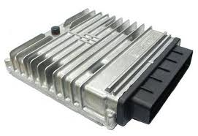
Embedded Software Development
Embedded software development is the process used to create the software for a computer system (embedded system) designed to perform one or a few dedicated functions. For example, an engine control unit (ECU)
Notes:
NOTE:This slide is optional. Depending on the audience you might need to explain what an embedded controller is and why the importance of it.
What is an embedded controller? An embedded controller is a computer system that is designed to perform a single function. An example of an embedded controller could be the box that controls your washer, or the multiple controllers in your vehicle.

Slide 5
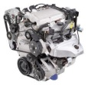
Control System
Controller
Plant
setpoint
error
+
-
Notes:
NOTE: This slide is optional. It depends on the audience. For people who are not familiar with control theory, you can use this slide to explain the concepts of plant and controller, closed loop and feedback.
So how does a control system look like? This is a very simple diagram that represents the main components in a closed control loop. The setpoint refers to the desired value that the plant (thing to control) should achieve. For example, a desired speed, a desired temperature, etc. The output of the plant is then compared to that setpoint and the result is the calculated error. For example, if the desired RPMs are 1000 rpm but the engine output is 985 rpm, then the error is 15 rpms. This error is then passed to a controller that figures out what is needed to stimulate the plant (engine) so that it can get to the 1000 rpms.

Slide 6

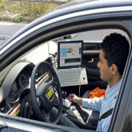
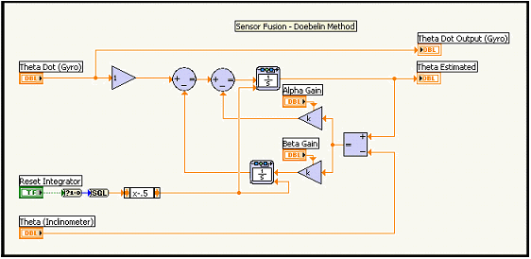
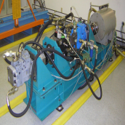
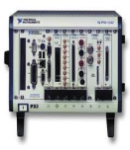
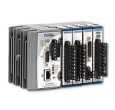
Embedded Software Development Process
Tests
Field Test
Calibration
Requirements
Gathering
Model Simulation
Physical Testing
Test Cells
Controller
Plant
Controller
Plant
+
-
+
-
Rapid Prototyping
Hardware in the Loop Testing
(HIL)
Code Generation and ECU Flashing
Notes:
There are several development processes for embedded systems. This slide shows one of them.
The development of an embedded controller should begin with requirements gathering, then move to simulation where you can use different tools for that. Then you do the rapid prototyping which means take your algorithm and embed it in a physical system that allows you to connect to real stimulus. In this case you could use a compactRIO and use the FPGA IO to connect to real signals. After the prototype is done, the next step is to deploy the algorithms into the “deployment” or final target. This side of the V has been the design portion. The following steps are the validation portion of the process.
First we do a Hardware in the Loop test where we connect the real controller to a simulation of the plant to validate its behavior. Then we do the physical testing where we connect the real controller to the real plant and test it. Lastly we perform what is called the calibration, that consists of tuning the controller for the specific plant.
This process reduces the development time by identifying errors sooner than later. Now, we have talked about doing tests on the validation portion of the V (right side), but there should also be tests on the right side of the V. As a matter of fact there should be tests through out every step in the process so that any error can be fed back to the cycle for correction.

Slide 7
Real-Time Testing (RTT)
Test that provides deterministic stimulus for reliability and accurate simulation of an environment
RTT Types:
Model in the loop (MIL)
Rapid Control Prototyping (RCP)
Hardware in the Loop (HIL)
Functional Testing / Test Cells
Notes:
Because these tests require stimulus that accurately represents the real signals, or needs some type of control, there is a need to run these tests in a real-time operating system. These tests are then called Real-Time Tests (RTT).
RTT has been grouped into four main tests:
MIL – Where everything is simulated.
RCP – Where the controller algorithm is running in a prototype box
HIL- Where the controller is the real target (deployment target) but the plant is simulated
Functional Tests – Where both, controller and plant are the real physical systems.

Slide 8
Test Continuity
MIL
RCP
HIL
Test Cell
Test Components
Test Components
Test Components
Test Components
Engine
Engine
Engine
Engine
ECM
ECM
ECM
ECM
Simulated
Real
Stimulus, Data Logging, User Interface, Analysis
Notes:
As seen in this slide, the different tests share to some extent the algorithms or physical systems by interchanging them depending on the type of test. One thing that can be common to all of them are the test components. By test components we mean the signal used to stimulate the system, the actual test, the reporting, the user interface, and the analysis performed to the acquired data. Reusing test components adds great value because it makes it easier to identify the source of an error, when you can use the same test, same stimulus and look at the same analysis throughout different phases of the development cycle.
For example, if you find an error in the HIL test, you can then give the test components to the MIL group and compare results to identify if the problem is in the plant model or if the problem is in the designed controller.

Slide 9
Embedded Software Development Process
MIL Testing
Field Test
Calibration
Requirements
Gathering
Model Simulation
Plant
Physical Testing
Test Cells
Plant
Controller
Controller
+
-
+
-
Rapid Prototyping
Hardware in the Loop Testing
(HIL)
Code Generation and ECU Flashing
Notes:
For this presentation I will focus on the Model In the Loop test but will explain how to go from MIL to HIL at the end of this presentation.

Slide 10
Model In the Loop (MIL) Manual Testing
Requirements
Notes:
The first step to test anything is to manually start defining the what the test will be. In this case, we start by analyzing the test requirements.

Slide 11
Requirements
Requirements
The test system will be used to validate an engine controller model with different environmental parameter values.
Environmental Conditions
Stimulus and Analysis
REQ_CoastalSummer_Conditions
Modify the engine model parameters to reflect coastal summer conditions:
Ambient Temperature = 90 deg
Ambient Pressure = 14.5 psi
REQ_MountainWinter_Conditions
Modify the engine model parameters to reflect mountain winter conditions:
Ambient Temperature = 20 deg
Ambient Pressure = 10.5 psi.
REQ_FTP1000_SpeedProfile
Exercise the engine, controller and application model closed loop with the FTP1000 speed profile.
REQ_NumExceptions_215
Analyze the load torque response vs engine speed. Then compare test results to Mask A. Number of exceptions (points outside the mask) should be less than 215.
Notes:
This slide shows the four test requirements that are defined in our requirements document and will be used in our demo.
The requirements basically say that we want to validate an engine controller by running two different tests. The first two requirements define the two tests by specifying two different environmental conditions (coastal summer and mountain winter) and the parameters that need to be modified. The other two requirements define the stimulus (FTP 1000) and analysis (comparison to mask A) that will be used during the tests.
Note: FTP stands for Federal Test Procedure.

Slide 12
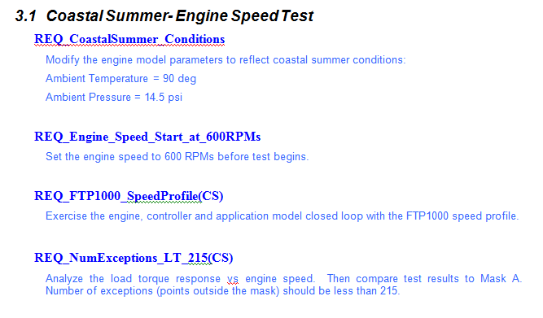
Model In the Loop (MIL) Manual Testing
Models
Requirements
Notes:
So once we know the requirements the next step is to define the models that need to be tested.

Slide 13
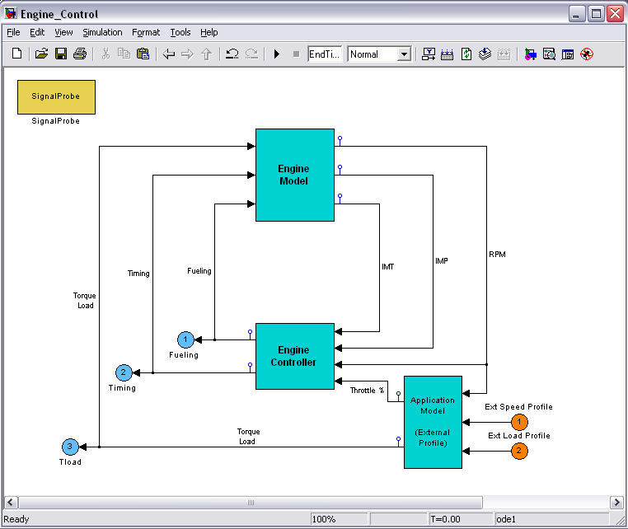
Engine Model
Models
Requirements
Notes:
These are the models that will be used in the demo. The three boxes in this high level model represent the controller, the plant (engine) and the application.
As seen in the slide, the model is doing the closed loop control within the same model. In our case, I took each blue box and compiled it into an independent DLL. We will close the loop with our test system, depending on the test type (HIL, MIL, RCP).

Slide 14
Model In the Loop (MIL) Manual Testing
Models
Stimulus Profile
Requirements
Notes:
So far we have defined the test requirements and the models. The next step is to define the stimulus profile that will be used to stimulate the models.

Slide 15
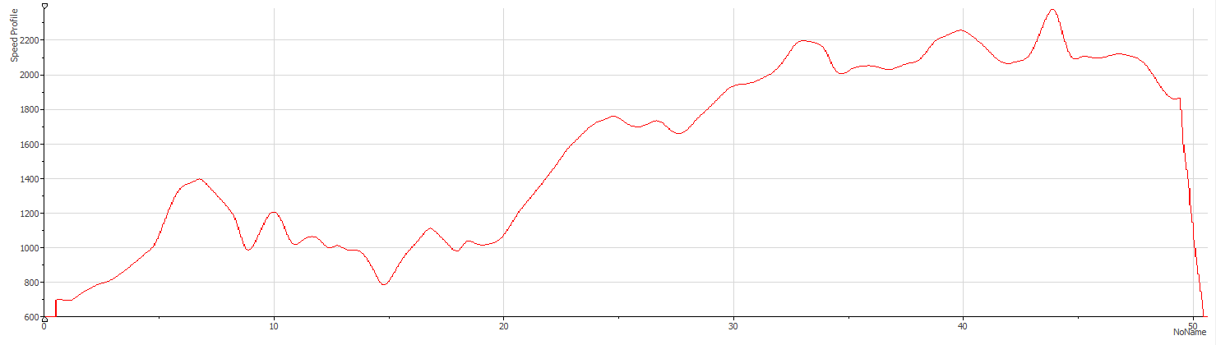
Engine FTP1000 Speed Profile
Models
Stimulus Profile
Requirements
Engine Speed (RPM)
Time (s)
Notes:
Based on the test requirements, we need to use the FTP 1000 as the stimulus profile. This is a screenshot of the FTP 1000. As wee can see, it is a waveform that defines the setpoint in RPMs that the engine should follow over time.

Slide 16
Model In the Loop (MIL) Manual Testing
Models
Stimulus Profile
Requirements
Analysis
Notes:
So far we have the test requirements that need to be covered, a group of models that need to be validated with certain parameters (temp and pressure) and a speed profile that will stimulate the system. What we are missing is the analysis that will tell if our algorithms pass or fail the tests.

Slide 17
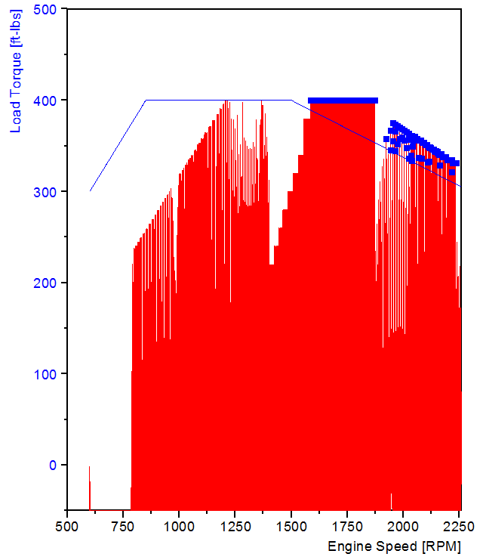
Speed/Torque Mask A Analysis
Models
Stimulus Profile
Requirements
Analysis
Notes:
Again, based from our test requirements, we need to compare the engine speed vs torque response and compare it to a mask. In this slide the area in red represents the speed/torque response from the engine and the line in blue represents the limit or mask. The points in blue represent errors or exceptions. Based on the test requirements if the number of exceptions is over or equal to 215, the controller fails the test.

Slide 18




Model In the Loop (MIL) Manual Testing
Models
Stimulus Profile
Requirements
Analysis
Notes:
With all the test components defined, the next step is to choose the tools to use for each of these components.
National Instruments has a tool for each of these components. Requirements gateway to track and gather requirements. NI VeriStand to run deterministically models and stimulus profiles, and NI DIAdem to run the analysis and generate reports.
What I’ll show later today is a demonstration of how all these tools are integrated in a single tool. It is important to understand that these are not the only tools that can be used. For example, instead of DIAdem, LabVIEW could be used to perform the analysis. The important thing is that as long as the tools that you choose to use have an API we should be able to plug it in the main architecture.

Slide 19
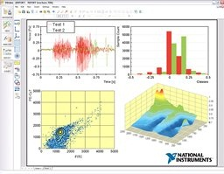
Application Software
NI Requirements Gateway
Requirements traceability
Impact analysis
Coverage reporting
NI DIAdem
Data management
Data visualization
Data Analysis and reporting
Notes:
These slides are OPTIONAL.
This is for people who don’t know the different software tools to quickly describe what they are for.

Slide 20
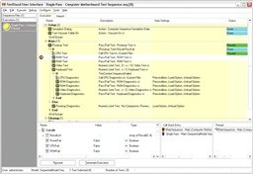

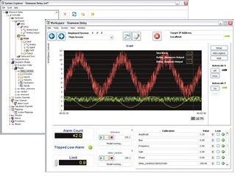
Application Software
NI TestStand
Test automation
Production test optimization
Batch test data collection and reporting
NI VeriStand
Real-Time control, stimulus, and data logging
Simulation automation and visualization
Control algorithm prototyping
Notes:
These slides are OPTIONAL.
This is for people who don’t know the different software tools to quickly describe what they are for.

Slide 21
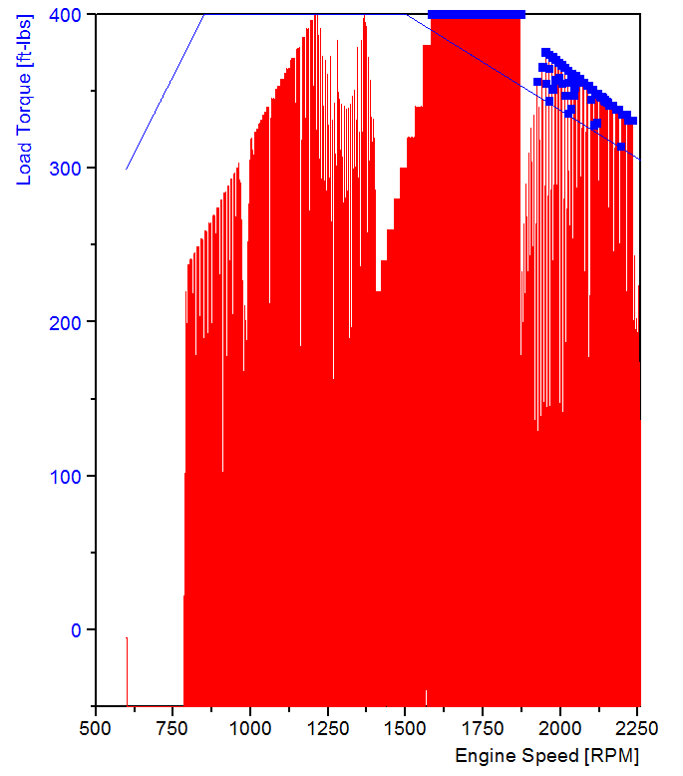
Model In the Loop (MIL) Manual Testing
Models
Stimulus Profile
Requirements
Analysis

Slide 22
Manual Testing Demo
Notes:
Depending on how much time you have, you might want to skip this step.
Review the RTTA Demo Script.docx for steps on how to run this demo
The demo consists of opening the Req Gateway project and explaining how the project is configured. Show how the requirements document has been linked and how the project is expecting a TS sequence.
Then I open VeriStand and go over the already configured VS project and explain the model mappings, run the model, set the parameters (temp and pressure) and run the stimulus profile.
Lastly I open DIAdem and manually do the analysis.
the

Slide 23
Model In the Loop (MIL) Automated Testing
Models
Stimulus Profile
Requirements
Analysis
Stimulus Profile
Analysis
Stimulus Profile
Analysis
Notes:
This process should be done a couple of times while the test is defined and more importantly to learn the common components and common steps that define the test procedure.
Once this happens, then we can start talking about automating the tests.

Slide 24
Model In the Loop (MIL) Automated Testing
Automation
Models
Stimulus Profiles
Analysis
Requirements
Notes:
In our case we use TestStand to automate the different tools that are used in the tests. This means, automating VeriStand and DIAdem through their APIs.
We also use TestStand to link back to the test requirements by talking to Requirements Gateway.

Slide 25
Model In the Loop (MIL) Automated Testing
Models
Stimulus Profiles
Analysis
Automation
Requirements
Models
Workspace
Stimulus Profile
Export Channels
Import Channels
Run Script
Notes:
VeriStand has a .NET API for accessing and executing, models, model parameters, and stimulus profiles among other functions. DIAdem has an ActiveX API to export and import channels, and run scripts among other functions.

Slide 26
Model In the Loop (MIL) Automated Testing
Automation Sequence
Run Stimulus Profile
Open VeriStand (VS)
Open VeriStand Config File
Set Model Parameters
Export Log
Run Analysis Script
Open DIAdem
Close DIAdem
Requirements
Notes:
This slide represents a very simple automated test sequence. The steps in purple represent calls to VeriStand to set parameters, run the models and run the stimulus profile. The boxes in yellow represent the steps to call DIAdem to run the data analysis.

Slide 27
Automated Demo
Notes:
This demos is also optional, depending how much time you have. I usually skip it since I’ll have a chance to explain the TS sequence in the NIGEL demo.
Review the RTTA Demo Script.docx for steps on how to run this demo
In this demo I open TestStand and go over an already created TS sequence that runs the test for the coastal summer conditions and run it.
NOTE : To generate this TestStand sequence I usually use the RTTA Ref Design (aka NIGEL) beforehand to generate a TS sequence that I can use at this point.

Slide 28
Model In the Loop (MIL) Scripting Real-Time Tests
Abstract the complexity of the test sequence creation
Define the test procedure
Provide a single tool that abstract other tools
Talk the same language as the user
Notes:
We’ve been talking about what a the test components are for a specific test type, in this case the MIL test. We have talked about how to manually define and develop the test components and how to automate them.
When we started defining the test components we started talking about the test requirements. These requirements were words in a text that didn’t have a specific software or hardware tool attached to them. Then we defined the tools to use, we developed the test components (building VS project and DIAdem scripts) and then we started automating these tools. At that point our test requirements were strictly tight to the tools we decided to use and reading a test sequence requires to know not only the test you want to perform but also the tools to be used.
What we need is a tool that abstracts the complexity of these tools; we need a tool that provides a single UI to define and run the test. What we need is something that can script a test but talk the same language the user is using.

Slide 29
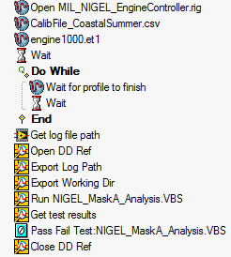
Model In the Loop (MIL) Scripting Real-Time Tests
Automated Test Sequence
Scripting Test
Use the NIGEL engine, controller and application model DLLs as the models to validate
Use the CalibFile_CoastalSummer.csv as model parameters file
Use the engine 1000.et1 as the stimulus profile
Use the NIGEL_MaskA_Analysis.VBS as the analysis script and reporting
Notes:
This means, going from the TestStand sequence on the left, that shows .NET steps and DIAdem steps to something similar to what we have on the right side.
Scripting a test basically is defining the test components to be used in the test (models, stimulus profiles, and analysis scripts) without worrying about the tools to use.
In this example, we define the Calibration file .csv as the file that contains the parameter values to reflect the coastal summer conditions. We also define the MaskA analysis .VBS as the analysis script without mentioning that it is a DIAdem script.
NOTE: In the demo, instead of just defining the models to be used, we had to use a VS project because when this tool was created there wasn’t an API to create a VS configuration file. In VS 2010 or later we have that API so now, anyone could create a tool that instead of specifying the VS project name, they could define the models to use as part of the test component.

Slide 30

Model In the Loop (MIL) Scripting Real-Time Tests
Scripting
Automation
Models
Stimulus Profiles
Analysis
Requirements
Notes:
To create a tool that can abstract this complexity, I am using LabVIEW to tie everything together. I am automating the automation tools.

Slide 31
MIL Scripting Demo
Notes:
Review the RTTA Demo Script.docx for steps on how to run this demo

Slide 32
Embedded Software Development Process
MIL Testing
HIL Testing
Field Test
Calibration
Requirements
Gathering
Model Simulation
Plant
Physical Testing
Test Cells
Plant
Controller
Controller
+
-
+
-
Rapid Prototyping
Hardware in the Loop Testing
(HIL)
Code Generation and ECU Flashing
Notes:
We just saw how to do MIL test but the real value that we have of creating such tools is to reuse the test components and go from MIL to HIL.
Here is how you could do it.
Review the RTTA Demo Script.docx for steps on how to run this demo Step 22 in the Scripting Demo section.

Slide 33
HIL Scripting Demo
Notes:
If you don’t have hardware, just use the RTTA ref desing (aka NIGEL) to go from MIL to HIL.

Slide 34
Questions?

